Slide 1
Building a Simple GUI Calculator with Python Tkinter
Notes:
Created from: https://www.geeksforgeeks.org/python/python-simple-gui-calculator-using-tkinter/

Slide 2
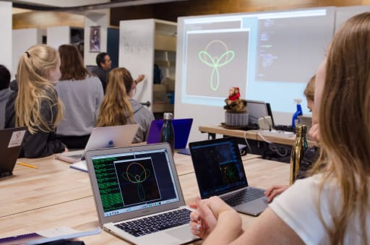
Opening Circle: Welcome to GUI Programming
Today we're learning how to create a graphical user interface (GUI) calculator using Python Tkinter
A GUI lets users interact with programs through buttons, windows, and displays instead of typing commands
By the end of this lesson, you'll understand how to build interactive applications that look professional
Let's start with a quick Think-Pair-Share: Think about a calculator app you use—what buttons and features does it have? Turn to a partner and discuss for 1 minute, then we'll share ideas with the class
Notes:
Image from: https://www.marlborough.org/news/~board/stem/post/computer-programming-classes-for-high-school-students

Slide 3
What is Tkinter?
Tkinter is Python's standard library for creating graphical user interfaces
It comes built-in with Python, so you don't need to install anything extra
Tkinter is the most popular choice for GUI development in Python because it's simple and powerful
It uses the Tk GUI toolkit, which has been trusted for decades in programming
You can create windows, buttons, text boxes, and much more with just a few lines of code

Slide 4
Why Choose Tkinter?
Fastest way to create GUI applications in Python
Easiest to learn for beginners
Built-in with Python—no extra downloads required
Perfect for creating simple to moderately complex applications
Cross-platform: works on Windows, Mac, and Linux

Slide 5
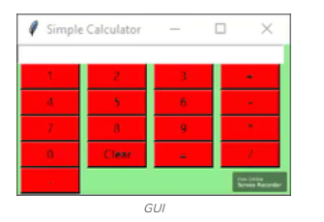
To create a Tkinter:
Importing the module – tkinter
Create the main window (container)
Add any number of widgets to the main window
Apply the event Trigger on the widgets.

Slide 6
Our Project: A Simple Calculator
We're building a calculator that performs four basic operations: addition, subtraction, multiplication, and division
The calculator will have a display screen showing numbers and results
It will have number buttons (0–9), operator buttons (+, −, ×, ÷), and special buttons (=, Clear, decimal point)
Users will click buttons to enter expressions, and the calculator will show the result
This project teaches you how widgets work together to create a functional application

Slide 7
Explanation:
press(key) appends input to expr and updates the display, equal() evaluates expr and shows result or error, clear() resets everything.
Sets up the main window with title, size, background and a StringVar display linked to an entry widget for showing input/output.
Numeric buttons (0–9) arranged in a grid, each calls press() with its number.
Operator buttons (+, -, *, /) placed in the grid, each calls press() with the operator symbol.
Additional buttons: = triggers calculation, Clear resets and . adds a decimal point.
Uses grid() layout for neat positioning buttons have uniform size and color, runs the Tkinter main event loop.

Slide 8
Understanding the Code Structure
The code has three main parts: functions, window setup, and widget creation
Functions handle what happens when buttons are clicked
Window setup configures the appearance and size of the calculator
Widget creation builds all the buttons and display screen
Everything runs inside the if __name__ == "__main__": block, which is Python best practice

Slide 9
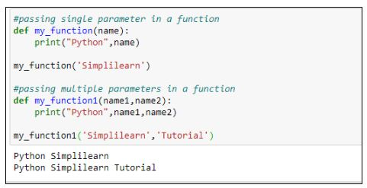
Function 1: The press() Function
press(key) is called every time you click a number or operator button
It takes the key you pressed and adds it to a global expression string
The expression string stores everything you've typed (like "5+3")
After adding the key, it updates the display so you see what you typed
This function is the heart of input handling in our calculator
Notes:
Image from: https://www.simplilearn.com.cach3.com/tutorials/python-tutorial/python-functions.html

Slide 10
Function 2: The equal() Function
equal() is called when you click the = button
It uses Python's eval() function to calculate the result of your expression
If the calculation works, it shows the result on the display
If there's an error (like dividing by zero), it displays "error"
After showing the result, it clears the expression string so you can start a new calculation

Slide 11
Function 3: The clear() Function
clear() is called when you click the Clear button
It resets the expression string to empty ("")
It clears the display so the screen shows nothing
This lets you start fresh with a new calculation
It's the simplest function but essential for usability

Slide 12
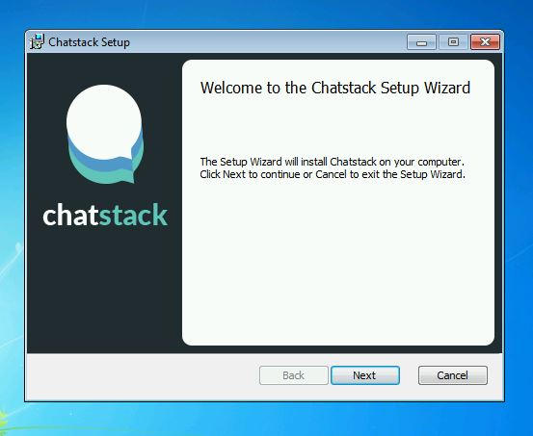
Setting Up the Main Window
root = Tk() creates the main window object
root.configure(bg="light green") sets the background color
root.title("Simple Calculator") sets the window title
root.geometry("270x150") sets the window size to 270 pixels wide by 150 pixels tall
These settings control how your calculator looks when it opens
You can change colors, size, and title to customize your calculator
Notes:
Image from: https://www.chatstack.com/kb/windows-app-installation/

Slide 13
Creating the Display Screen
display = StringVar() creates a variable that holds text and updates automatically
Entry(root, textvariable=display) creates a text box linked to the display variable
entry.grid(columnspan=4, ipadx=70) places the display across 4 columns with extra padding
When you press buttons, the display updates to show your input
The display is read-only for users—they can't type directly into it

Slide 14
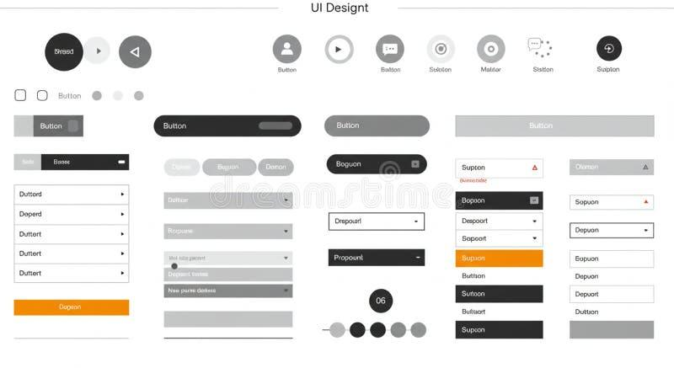
Building Number Buttons (0–9)
Each number button is created with Button() and given properties like text, color, and size
fg='black' sets the text color to black
bg='red' sets the button background to red
command=lambda: press(1) tells the button to call press(1) when clicked
height=1, width=7 makes all buttons the same size
grid(row=X, column=Y) positions each button in a specific location
Numbers 1–3 go in row 2, numbers 4–6 in row 3, numbers 7–9 in row 4, and 0 in row 5
Notes:
Image from: https://www.dreamstime.com/ui-design-concept-featuring-various-interface-elements-such-as-buttons-dropdowns-ui-design-concept-featuring-various-interface-image363839422

Slide 15
Building Operator Buttons (+, −, ×, ÷)
Operator buttons are created the same way as number buttons
The + button is placed in row 2, column 3 (right side)
The − button is in row 3, column 3
The × button is in row 4, column 3
The ÷ button is in row 5, column 3
Each operator button calls press() with its symbol when clicked
Grouping operators on the right side makes the layout intuitive

Slide 16
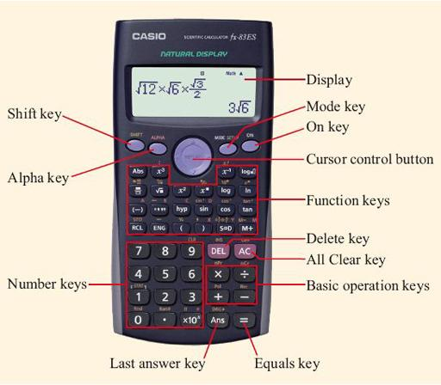
Building Special Buttons (=, Clear, Decimal)
The = button calls equal() instead of press()—it calculates the result
The Clear button calls clear()—it resets everything
The decimal point (.) button calls press('.')—it adds a decimal to your number
These buttons are positioned at the bottom of the calculator
They provide essential functionality beyond basic arithmetic
Notes:
Image from: https://www.open.edu/openlearn/mod/oucontent/view.php?printable=1&id=4256

Slide 17
Understanding the Grid Layout System
grid() is Tkinter's layout manager that arranges widgets in rows and columns
Think of it like a spreadsheet: each widget has a row number and column number
columnspan=4 makes the display stretch across 4 columns
ipadx=70 adds extra horizontal padding inside the display box
height and width control button size
This system makes it easy to create organized, professional-looking interfaces

Slide 18
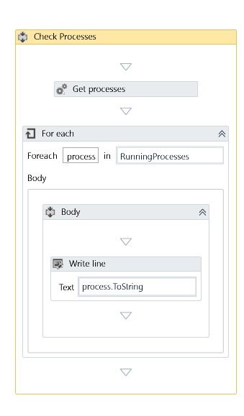
Running Your Calculator: root.mainloop()
root.mainloop() starts the calculator and keeps it running
It listens for events (button clicks, window closing) continuously
Without mainloop(), your window would appear and immediately close
The program stays in this loop until you close the window
This is the final line of every Tkinter application
Notes:
Image from: https://forum.uipath.com/t/how-to-detect-open-application-running-in-the-background/28352

Slide 19
Compass Points Protocol: What Interests You Most?
Move to a corner based on what excites you most about this project:
NORTH: Creating the visual interface and button layout
SOUTH: Understanding how functions handle calculations
EAST: Customizing colors, sizes, and appearance
WEST: Adding new features like more operations or memory functions
Once in your corner, discuss with others why you chose that aspect
Be ready to share one insight with the whole class

Slide 20

Customizing Your Calculator
Change colors: Replace 'red' with 'blue', 'green', 'yellow', or any color name
Change window size: Modify the geometry() values to make it bigger or smaller
Change background: Use root.configure(bg="your_color")
Add more buttons: Create new buttons and grid() them in empty spaces
Change fonts: Add font=("Arial", 12) to Entry() or Button() to customize text
Experiment with these changes to make the calculator your own
Notes:
Image from: https://orthopracticeus.com/customized-orthodontic-appliances-theory-design-application/

Slide 21
Common Errors and How to Fix Them
SyntaxError: Check that all parentheses, brackets, and quotes are matched
NameError: Make sure you imported tkinter with "from tkinter import *"
Button not working: Verify the command= parameter is spelled correctly
Display not updating: Check that you're using StringVar() and textvariable=
Window won't close: Make sure mainloop() is at the very end of your code
Test your code frequently to catch errors early

Slide 22
Next Steps: Your Challenge
Build this calculator yourself by typing the code (don't copy-paste)
Test it by clicking buttons and performing calculations
Customize at least three things: colors, size, or button layout
Try adding a new button or feature (hint: you can add a square root button!)
Share your customized calculator with a classmate and explain your changes
Be ready to demonstrate your working calculator next class

Slide 23
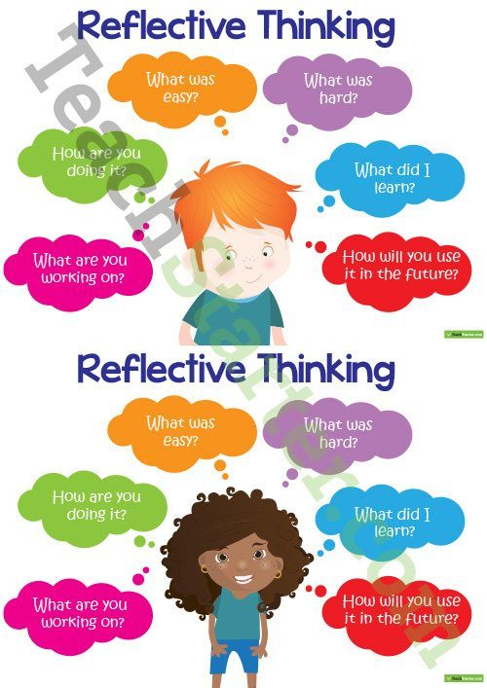
Exit Ticket: Reflect on Your Learning
On a piece of paper or digital form, answer these questions:
What is one thing you learned about Tkinter today?
Which function (press, equal, or clear) do you understand best, and why?
What's one feature you'd like to add to this calculator?
What question do you still have about GUI programming?
Turn in your exit ticket as you leave—this helps me know what to review next class
Notes:
Image from: https://www.pinterest.com/pin/8-fun-and-effective-lesson-closures--521362094364145586/

